Slide 1
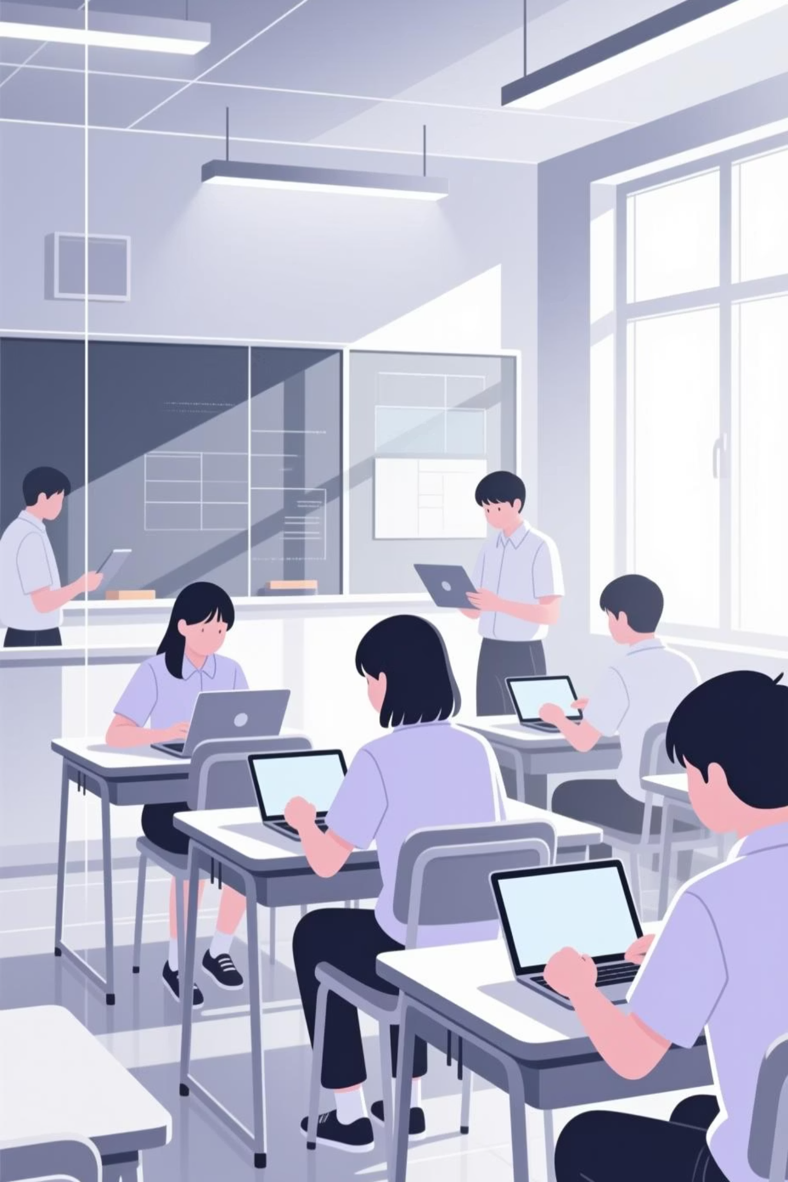
The Role of Computers in Modern Education
In the 21st century, technology has moved from the periphery of the classroom to its very core. Computers are no longer just tools; they are the gateways to knowledge, collaboration, and the essential digital literacy skills required for the future.

Slide 2
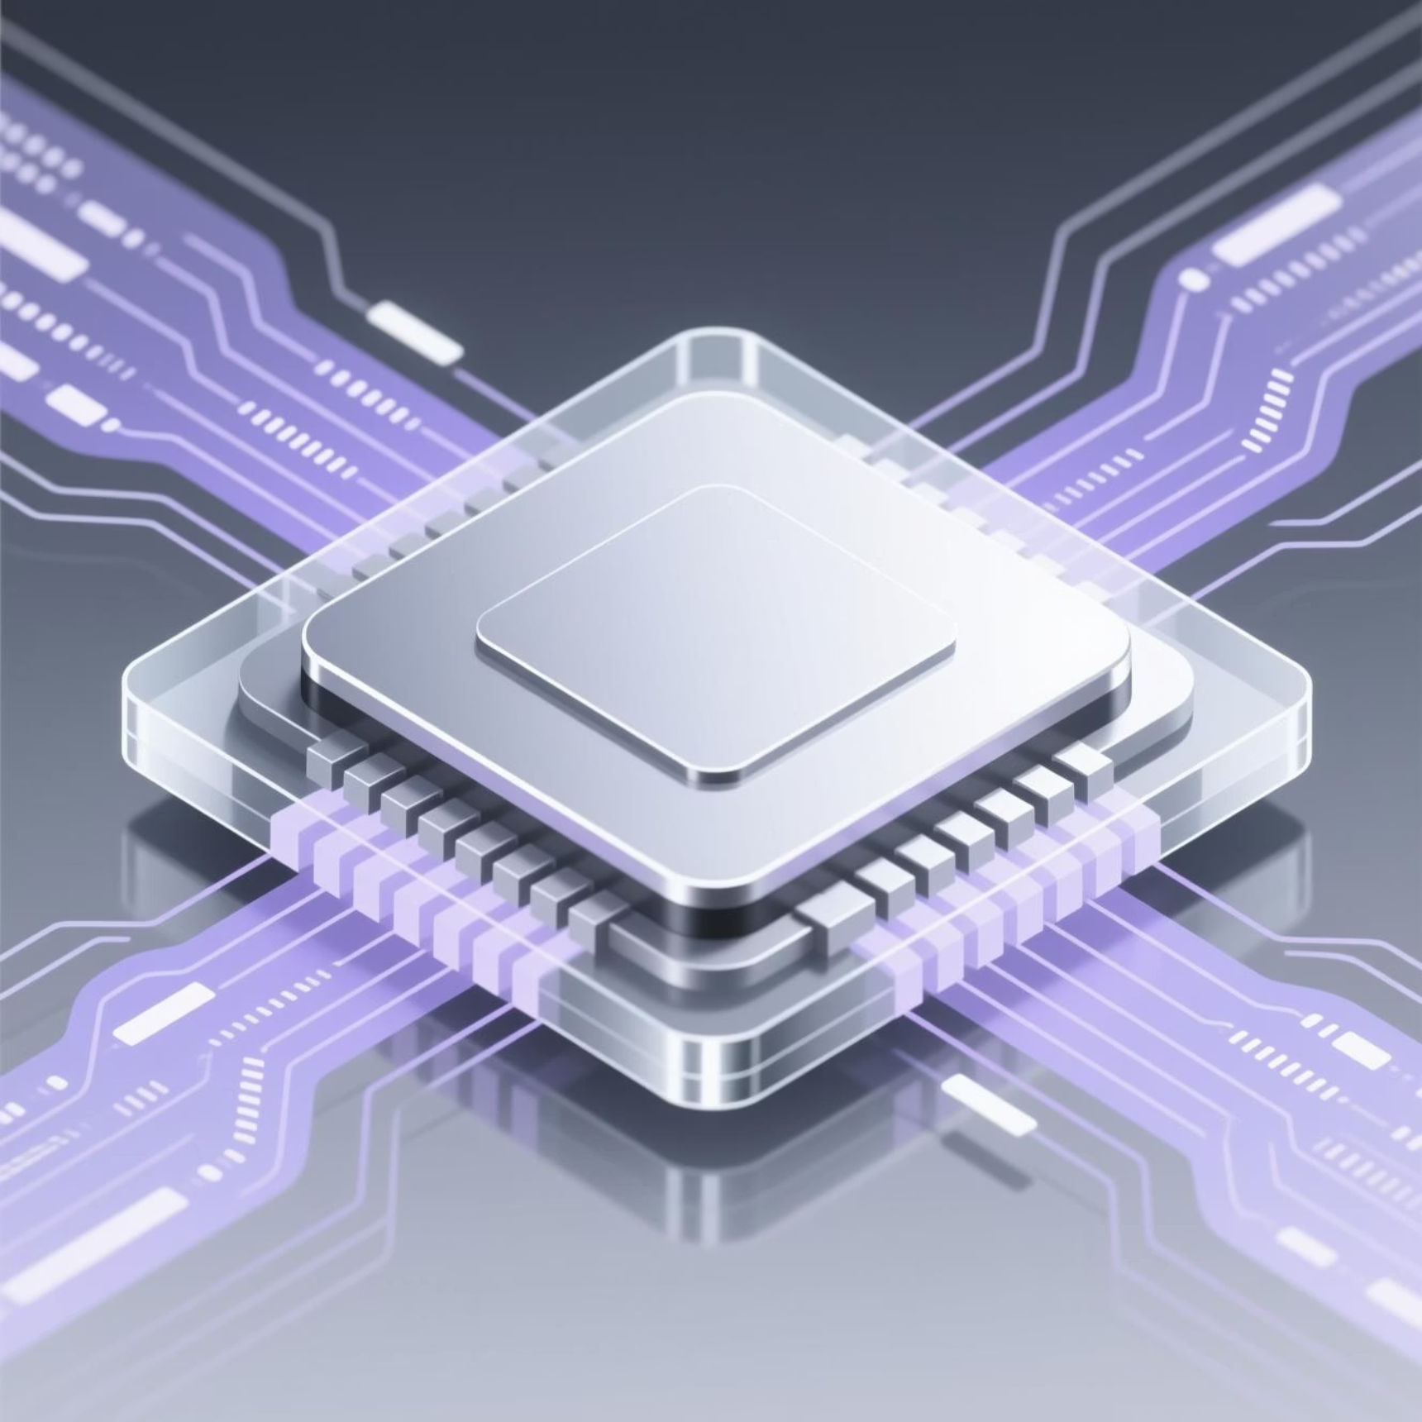

Why Computers Matter in Education Today
Information Mastery
Computers enable the efficient storage and lightning-fast processing of vast amounts of data, allowing students to focus on analysis rather than just memorization.
Dynamic Pedagogy
They transform traditional teaching by replacing static textbooks with multimedia and interactive tools that cater to various learning styles.
Modern classrooms leverage these tools to build high-interest environments where curiosity meets immediate capability.

Slide 3

Key Advantages of Digital Learning
Vast Information Access
Seamless Communication
Audio-Visual Integration
The Internet provides an unparalleled library of resources, from academic journals to real-time global news, accessible in seconds.
Enhanced platforms bridge the gap between students, teachers, and parents, fostering a collaborative community and instant feedback.
Complex concepts are simplified through the use of high-quality audio-visual aids, leading to significantly better retention and understanding.

Slide 4
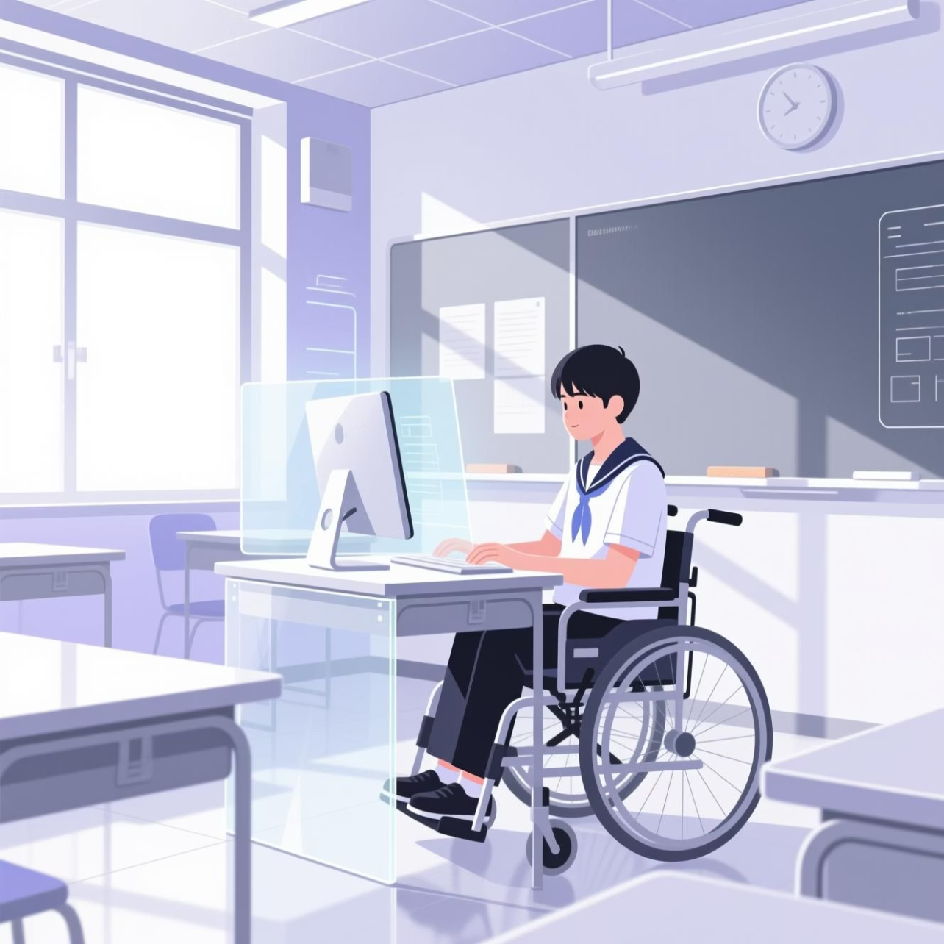
Computers Supporting Special Needs
Computers serve as a powerful equalizer in the classroom. Assistive technologies break down barriers for students with disabilities, ensuring every learner has a seat at the digital table.
Screen Readers: Converting text to speech for visually impaired learners.
Adaptive Devices: Custom keyboards and eye-tracking software for physical mobility challenges.
Speech-to-Text: Empowering students with writing difficulties.
Inclusive Learning

Slide 5
Challenges and Considerations
While the benefits are immense, the integration of technology requires a strategic and cautious approach to ensure student safety and efficacy.
Distraction Management
Teacher Training
Cybersecurity
Unfiltered access can lead to significant distractions if digital environments are not properly structured and managed.
Technology is only as good as its user; educators need ongoing professional development to integrate tools effectively.
Protecting sensitive student data and teaching digital citizenship is a critical priority for every modern institution.

Slide 6
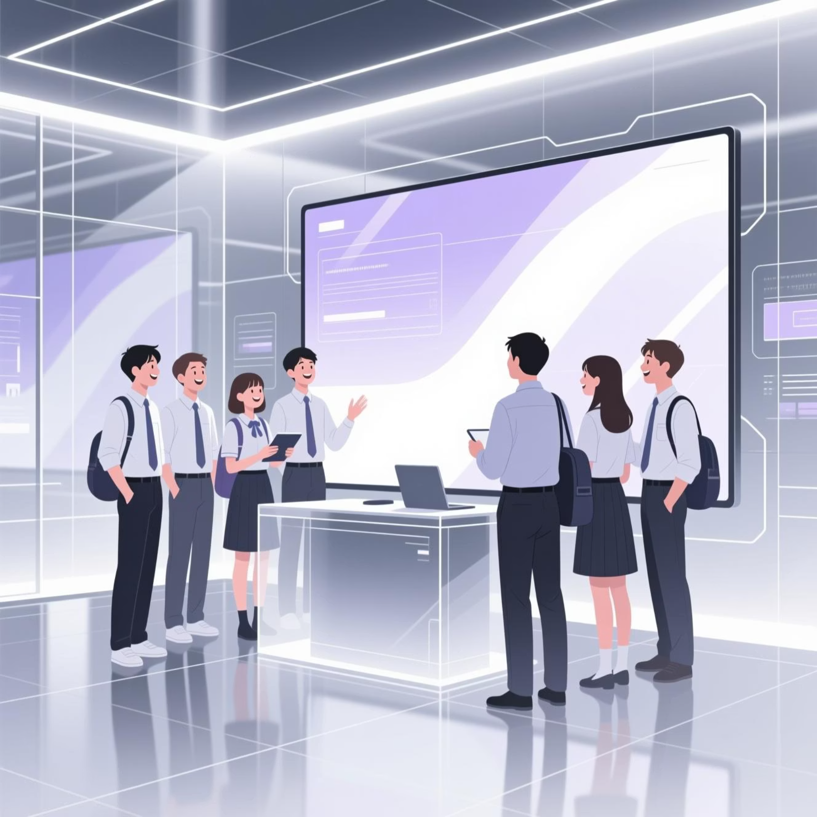
Embracing the Digital Future
Empower. Engage. Educate.
Computers are indispensable in modern education. They provide the accessibility, engagement, and skill-building necessary for the next generation of leaders.
Let’s prepare learners for a digital future!
Through thoughtful integration and robust support systems, we can create a learning experience that truly reflects the world outside our windows.

